Slide 1
Firms in Competitive Markets
© 2015 Cengage Learning. All Rights Reserved. May not be copied, scanned, or duplicated, in whole or in part, except for use as permitted in a license distributed with a certain product or service or otherwise on a password-protected website for classroom use.

Slide 2
What is a Competitive Market?
Competitive market
  Perfectly competitive market
  Market with many buyers and sellers
  Trading identical products
  Each buyer and seller is a price taker
  Firms can freely enter or exit the market
© 2015 Cengage Learning. All Rights Reserved. May not be copied, scanned, or duplicated, in whole or in part, except for use as permitted in a license distributed with a certain product or service or otherwise on a password-protected website for classroom use.

Slide 3
What is a Competitive Market?
Firm in a competitive market
  Tries to maximize profit
Profit
  Total revenue minus total cost
Total revenue, TR = P ˣ Q
  Price times quantity
  Proportional to the amount of output
© 2015 Cengage Learning. All Rights Reserved. May not be copied, scanned, or duplicated, in whole or in part, except for use as permitted in a license distributed with a certain product or service or otherwise on a password-protected website for classroom use.

Slide 4
What is a Competitive Market?
Average revenue, AR = TR / Q
  Total revenue divided by the quantity sold
Marginal revenue, MR = ∆TR / ∆Q
  Change in total revenue from an additional unit sold
For competitive firms
  AR = P
  MR = P
© 2015 Cengage Learning. All Rights Reserved. May not be copied, scanned, or duplicated, in whole or in part, except for use as permitted in a license distributed with a certain product or service or otherwise on a password-protected website for classroom use.

Slide 5
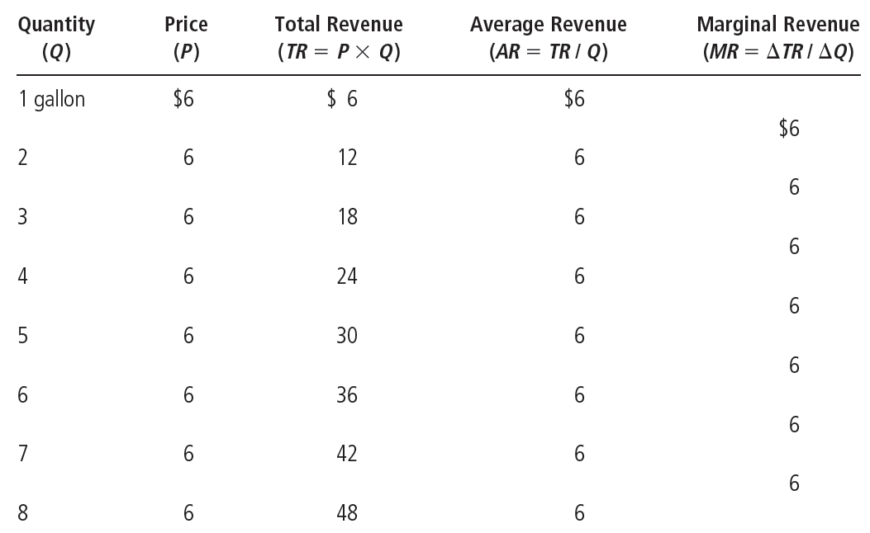
Table 1
Total, Average, and Marginal Revenue for a Competitive Firm
© 2015 Cengage Learning. All Rights Reserved. May not be copied, scanned, or duplicated, in whole or in part, except for use as permitted in a license distributed with a certain product or service or otherwise on a password-protected website for classroom use.

Slide 6
Profit Maximization
Maximize profit
  Produce quantity where total revenue minus total cost is greatest
  Compare marginal revenue with marginal cost
    If MR > MC: increase production
    If MR < MC: decrease production
    Maximize profit where MR = MC
© 2015 Cengage Learning. All Rights Reserved. May not be copied, scanned, or duplicated, in whole or in part, except for use as permitted in a license distributed with a certain product or service or otherwise on a password-protected website for classroom use.

Slide 7
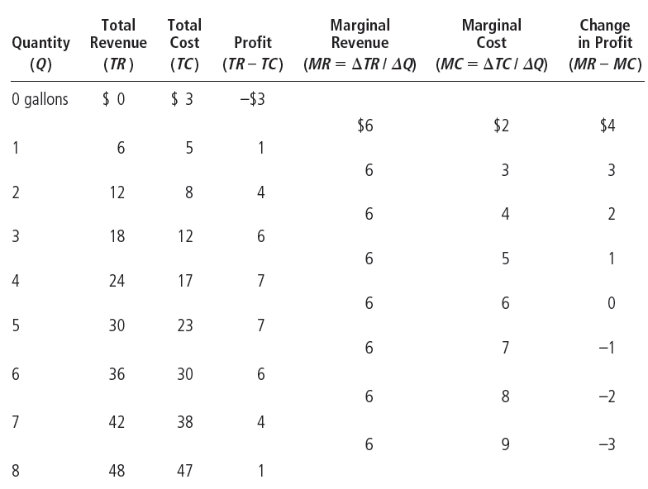
Table 2
Profit Maximization: A Numerical Example
© 2015 Cengage Learning. All Rights Reserved. May not be copied, scanned, or duplicated, in whole or in part, except for use as permitted in a license distributed with a certain product or service or otherwise on a password-protected website for classroom use.

Slide 8
Profit Maximization
The marginal-cost curve and the firm’s supply decision
  MC curve is upward sloping
  ATC curve is U-shaped
  MC curve crosses the ATC curve at the minimum of ATC curve
  The price line is horizontal: P = AR = MR
© 2015 Cengage Learning. All Rights Reserved. May not be copied, scanned, or duplicated, in whole or in part, except for use as permitted in a license distributed with a certain product or service or otherwise on a password-protected website for classroom use.

Slide 9
Figure 1
Profit Maximization for a Competitive Firm
Costs
and
Revenue
The firm maximizes profit by producing the quantity at which marginal cost equals marginal revenue.
MC
MC₂
ATC
P=MR₁=MR₂
P=AR=MR
AVC
MC₁
0
Q₁
Q_{MAX}
Q₂
Quantity
This figure shows the marginal-cost curve (MC), the average-total-cost curve (ATC), and the average-variable-cost curve (AVC). It also shows the market price (P), which for a competitive firm equals both marginal revenue (MR) and average revenue (AR). At the quantity Q₁, marginal revenue MR₁ exceeds marginal cost MC₁, so raising production increases profit. At the quantity Q₂, marginal cost MC₂ is above marginal revenue MR₂, so reducing production increases profit. The profit-maximizing quantity Q_{MAX} is found where the horizontal line representing the price intersects the marginal-cost curve.
© 2015 Cengage Learning. All Rights Reserved. May not be copied, scanned, or duplicated, in whole or in part, except for use as permitted in a license distributed with a certain product or service or otherwise on a password-protected website for classroom use.

Slide 10
Profit Maximization
Rules for profit maximization:
  If MR > MC, firm should increase output
  If MC > MR, firm should decrease output
  If MR = MC, profit-maximizing level of output
Marginal-cost curve
  Determines the quantity of the good the firm is willing to supply at any price
  Is the supply curve
© 2015 Cengage Learning. All Rights Reserved. May not be copied, scanned, or duplicated, in whole or in part, except for use as permitted in a license distributed with a certain product or service or otherwise on a password-protected website for classroom use.

Slide 11
Figure 2
Marginal Cost as the Competitive Firm’s Supply Curve
Price
MC
P₂
ATC
P₁
AVC
0
Q₁
Q₂
Quantity
An increase in the price from P₁ to P₂ leads to an increase in the firm’s profit-maximizing quantity from Q₁ to Q₂. Because the marginal-cost curve shows the quantity supplied by the firm at any given price, it is the firm’s supply curve.
© 2015 Cengage Learning. All Rights Reserved. May not be copied, scanned, or duplicated, in whole or in part, except for use as permitted in a license distributed with a certain product or service or otherwise on a password-protected website for classroom use.

Slide 12
Profit Maximization
Shutdown
  Short-run decision not to produce anything
  During a specific period of time
  Because of current market conditions
  Firm still has to pay fixed costs
Exit
  Long-run decision to leave the market
  Firm doesn’t have to pay any costs
© 2015 Cengage Learning. All Rights Reserved. May not be copied, scanned, or duplicated, in whole or in part, except for use as permitted in a license distributed with a certain product or service or otherwise on a password-protected website for classroom use.

Slide 13
Profit Maximization
The firm’s short-run decision to shut down
  TR = total revenue
  VC = variable costs
Firm’s decision:
  Shut down if TR < VC (P < AVC)
Competitive firm’s short-run supply curve
  The portion of its marginal-cost curve
  That lies above average variable cost
© 2015 Cengage Learning. All Rights Reserved. May not be copied, scanned, or duplicated, in whole or in part, except for use as permitted in a license distributed with a certain product or service or otherwise on a password-protected website for classroom use.

Slide 14
Figure 3
The Competitive Firm’s Short-Run Supply Curve
Costs
1. In the short run, the firm produces on the MC curve if P>AVC,...
MC
ATC
AVC
2. ...but
shuts down
if P<AVC.
0
Quantity
In the short run, the competitive firm’s supply curve is its marginal-cost curve (MC) above average variable cost (AVC). If the price falls below average variable cost, the firm is better off shutting down temporarily.
© 2015 Cengage Learning. All Rights Reserved. May not be copied, scanned, or duplicated, in whole or in part, except for use as permitted in a license distributed with a certain product or service or otherwise on a password-protected website for classroom use.

Slide 15
Profit Maximization
Sunk cost
  A cost that has already been committed and cannot be recovered
  Should be ignored when making decisions
  “Don’t cry over spilt milk”
  “Let bygones be bygones”
  In the short run, fixed costs are sunk costs
© 2015 Cengage Learning. All Rights Reserved. May not be copied, scanned, or duplicated, in whole or in part, except for use as permitted in a license distributed with a certain product or service or otherwise on a password-protected website for classroom use.

Slide 16

Near-empty restaurants & off-season miniature golf
Restaurant – stay open for lunch?
  Fixed costs
    Not relevant
    Are sunk costs in short run
  Variable costs – relevant
  Shut down if revenue from lunch < variable costs
  Stay open if revenue from lunch > variable costs
Staying open can be profitable, even with many tables empty.
© 2015 Cengage Learning. All Rights Reserved. May not be copied, scanned, or duplicated, in whole or in part, except for use as permitted in a license distributed with a certain product or service or otherwise on a password-protected website for classroom use.

Slide 17
Near-empty restaurants & off-season miniature golf
Operator of a miniature-golf course
  Ignore fixed costs
  Shut down if
    Revenue < variable costs
  Stay open if
    Revenue > variable costs
© 2015 Cengage Learning. All Rights Reserved. May not be copied, scanned, or duplicated, in whole or in part, except for use as permitted in a license distributed with a certain product or service or otherwise on a password-protected website for classroom use.

Slide 18
Profit Maximization
Firm’s long-run decision
  Exit the market if
    Total revenue < total costs; TR < TC
      Same as: P < ATC
  Enter the market if
    Total revenue > total costs; TR > TC
      Same as: P > ATC
Competitive firm’s long-run supply curve
  The portion of its marginal-cost curve that lies above average total cost
© 2015 Cengage Learning. All Rights Reserved. May not be copied, scanned, or duplicated, in whole or in part, except for use as permitted in a license distributed with a certain product or service or otherwise on a password-protected website for classroom use.

Slide 19
Figure 4
The Competitive Firm’s Long-Run Supply Curve
Costs
1. In the long run, the firm produces on the MC curve if P>ATC,...
MC
ATC
2. ...but exits if P<ATC
0
Quantity
In the long run, the competitive firm’s supply curve is its marginal-cost
curve (MC) above average total cost (ATC). If the price falls below average total cost, the firm is better off exiting the market.
© 2015 Cengage Learning. All Rights Reserved. May not be copied, scanned, or duplicated, in whole or in part, except for use as permitted in a license distributed with a certain product or service or otherwise on a password-protected website for classroom use.

Slide 20
Profit Maximization
Measuring profit
  If P > ATC
    Profit = TR – TC = (P – ATC) ˣ Q
  If P < ATC
    Loss = TC - TR = (ATC – P) ˣ Q
    = Negative profit
© 2015 Cengage Learning. All Rights Reserved. May not be copied, scanned, or duplicated, in whole or in part, except for use as permitted in a license distributed with a certain product or service or otherwise on a password-protected website for classroom use.

Slide 21
Figure 5
Profit as the Area between Price and Average Total Cost
(a) A firm with profits
(b) A firm with losses
Price
Price
MC
MC
Profit
ATC
Loss
ATC
P
ATC
P=AR=MR
ATC
P
P=AR=MR
0
Q
(profit-maximizing quantity)
0
Quantity
Q
(loss-minimizing quantity)
Quantity
The area of the shaded box between price and average total cost represents the firm’s profit. The height of this box is price minus average total cost (P – ATC), and the width of the box is the quantity of output (Q). In panel (a), price is above average total cost, so the firm has positive profit. In panel (b), price is less than average total cost, so the firm incurs a loss.
© 2015 Cengage Learning. All Rights Reserved. May not be copied, scanned, or duplicated, in whole or in part, except for use as permitted in a license distributed with a certain product or service or otherwise on a password-protected website for classroom use.

Slide 22
Supply Curve
Short run: market supply with a fixed number of firms
  Short run: number of firms is fixed
  Each firm supplies quantity where P = MC
    For P > AVC: supply curve is MC curve
  Market supply
    Add up quantity supplied by each firm
© 2015 Cengage Learning. All Rights Reserved. May not be copied, scanned, or duplicated, in whole or in part, except for use as permitted in a license distributed with a certain product or service or otherwise on a password-protected website for classroom use.

Slide 23
Figure 6
Short-Run Market Supply
(a) Individual firm supply
(b) Market supply
Price
Price
MC
Supply
$2.00
$2.00
1.00
1.00
0
100
200
Quantity
(firm)
0
100,000
200,000
Quantity
(market)
In the short run, the number of firms in the market is fixed. As a result, the market supply curve, shown in panel (b), reflects the individual firms’ marginal-cost curves, shown in panel (a). Here, in a market of 1,000 firms, the quantity of output supplied to the market is 1,000 times the quantity supplied by each firm.
© 2015 Cengage Learning. All Rights Reserved. May not be copied, scanned, or duplicated, in whole or in part, except for use as permitted in a license distributed with a certain product or service or otherwise on a password-protected website for classroom use.

Slide 24
Supply Curve
Long run
  Firms can enter and exit the market
  If P > ATC, firms make positive profit
    New firms enter the market
  If P < ATC, firms make negative profit
    Firms exit the market
© 2015 Cengage Learning. All Rights Reserved. May not be copied, scanned, or duplicated, in whole or in part, except for use as permitted in a license distributed with a certain product or service or otherwise on a password-protected website for classroom use.

Slide 25
Supply Curve
Long run
  Process of entry and exit ends when
    Firms still in market make zero economic profit (P = ATC)
    Because MC = ATC: Efficient scale
  Long run supply curve is perfectly elastic
    Horizontal at minimum ATC
© 2015 Cengage Learning. All Rights Reserved. May not be copied, scanned, or duplicated, in whole or in part, except for use as permitted in a license distributed with a certain product or service or otherwise on a password-protected website for classroom use.

Slide 26
Figure 7
Long-Run Market Supply
(a) Firm’s Zero-Profit Condition
(b) Market supply
Price
Price
MC
ATC
P=
minimum
ATC
Supply
0
Quantity
(firm)
0
Quantity
(market)
In the long run, firms will enter or exit the market until profit is driven to zero. As a result, price equals the minimum of average total cost, as shown in panel (a). The number of firms adjusts to ensure that all demand is satisfied at this price. The long-run market supply curve is horizontal at this price, as shown in panel (b).
© 2015 Cengage Learning. All Rights Reserved. May not be copied, scanned, or duplicated, in whole or in part, except for use as permitted in a license distributed with a certain product or service or otherwise on a password-protected website for classroom use.

Slide 27
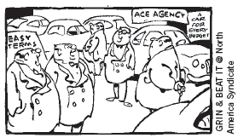
Supply Curve
Why do competitive firms stay in business if they make zero profit?
  Profit = total revenue – total cost
  Total cost includes all opportunity costs
  Zero-profit equilibrium
    Economic profit is zero
    Accounting profit is positive
“We’re a nonprofit organization - we don’t intend to be, but we are!”
© 2015 Cengage Learning. All Rights Reserved. May not be copied, scanned, or duplicated, in whole or in part, except for use as permitted in a license distributed with a certain product or service or otherwise on a password-protected website for classroom use.

Slide 28
Supply Curve
Market in long run equilibrium
  P = minimum ATC
  Zero economic profit
Increase in demand
  Demand curve shifts outward
  Short run
    Higher quantity
    Higher price: P > ATC – positive economic profit
© 2015 Cengage Learning. All Rights Reserved. May not be copied, scanned, or duplicated, in whole or in part, except for use as permitted in a license distributed with a certain product or service or otherwise on a password-protected website for classroom use.

Slide 29
Supply Curve
Positive economic profit in short run
  Long run – firms enter the market
  Short run supply curve – shifts right
  Price – decreases back to minimum ATC
  Quantity – increases
    Because there are more firms in the market
  Efficient scale
© 2015 Cengage Learning. All Rights Reserved. May not be copied, scanned, or duplicated, in whole or in part, except for use as permitted in a license distributed with a certain product or service or otherwise on a password-protected website for classroom use.

Slide 30
Figure 8
An Increase in Demand in the Short Run and Long Run (a)
(a) Initial Condition
Market
Firm
Price
Price
1. A market begins in
long-run equilibrium…
2. …with the firm
earning zero profit.
Short-run supply, S₁
MC
ATC
A
Long-run
supply
P₁
P₁
Demand, D₁
0
Q₁
Quantity
(market)
0
Quantity
(firm)
The market starts in a long-run equilibrium, shown as point A in panel (a). In this equilibrium, each firm makes zero profit, and the price equals the minimum average total cost.
© 2015 Cengage Learning. All Rights Reserved. May not be copied, scanned, or duplicated, in whole or in part, except for use as permitted in a license distributed with a certain product or service or otherwise on a password-protected website for classroom use.

Slide 31
Figure 8
An Increase in Demand in the Short Run and Long Run (b)
(b) Short-Run Response
Market
Firm
Price
3. But then an increase in demand raises the price…
Price
4. …leading to
short-run profits.
S₁
MC
ATC
B
P₂
A
P₂
P₁
Long-run
supply
P₁
D₂
D₁
0
Q₁
Q₂
Quantity
(market)
0
Quantity
(firm)
Panel (b) shows what happens in the short run when demand rises from D₁ to D₂. The equilibrium goes from point A to point B, price rises from P₁ to P₂, and the quantity sold in the market rises from Q₁ to Q₂. Because price now exceeds average total cost, each firm now makes a profit, which over time encourages new firms to enter the market.
© 2015 Cengage Learning. All Rights Reserved. May not be copied, scanned, or duplicated, in whole or in part, except for use as permitted in a license distributed with a certain product or service or otherwise on a password-protected website for classroom use.

Slide 32
Figure 8
An Increase in Demand in the Short Run and Long Run (c)
(c) Long-Run Response
Market
Firm
Price
Price
6. …restoring long-run equilibrium.
5. When profits induce entry, supply increases and the price falls,…
S₁
MC
S₂
ATC
B
P₂
A
C
Long-run
supply
P₁
P₁
D₂
D₁
0
Q₁
Q₂
Q₃
Quantity
(market)
0
Quantity
(firm)
This entry shifts the short-run supply curve to the right from S₁ to S₂, as shown in panel (c). In the new long-run equilibrium, point C, price has returned to P₁ but the quantity sold has increased to Q₃. Profits are again zero, and price is back to the minimum of average total cost, but the market has more firms to satisfy the greater demand.
© 2015 Cengage Learning. All Rights Reserved. May not be copied, scanned, or duplicated, in whole or in part, except for use as permitted in a license distributed with a certain product or service or otherwise on a password-protected website for classroom use.

Slide 33
Supply Curve
Long-run supply curve might slope upward
  Some resource used in production may be available only in limited quantities
    Increase in quantity supplied – increase in costs – increase in price
  Firms may have different costs
    Some firms earn profit even in the long run
Long-run supply curve
  More elastic than short-run supply curve
© 2015 Cengage Learning. All Rights Reserved. May not be copied, scanned, or duplicated, in whole or in part, except for use as permitted in a license distributed with a certain product or service or otherwise on a password-protected website for classroom use.

